Slide 1
Phishing Awareness
CodeAlpha Internship
By: Baher Adawy

Slide 2

What is Phishing
“Phishing” refers to an attempt to steal sensitive information.
Data is typically stolen in the form of usernames, passwords, credit card numbers, bank account information or other important data to utilize or sell the stolen information.

Slide 3
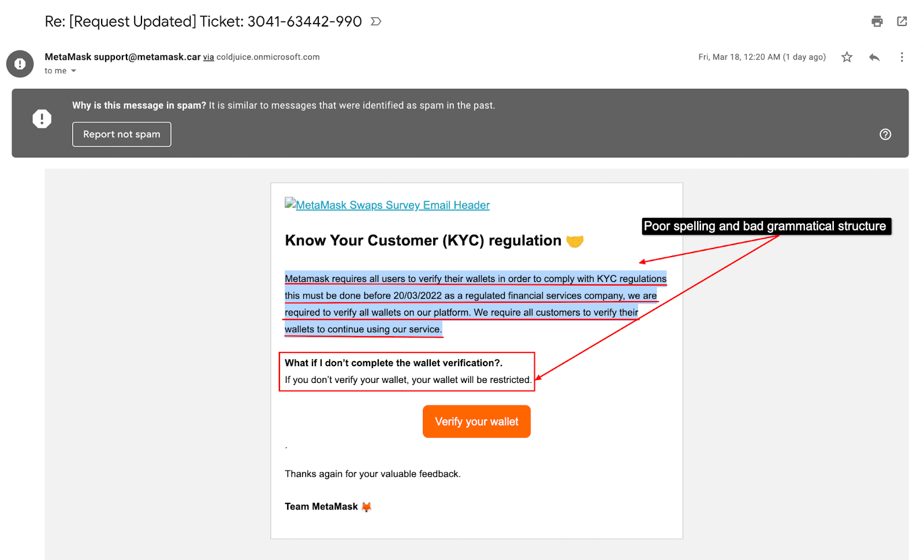
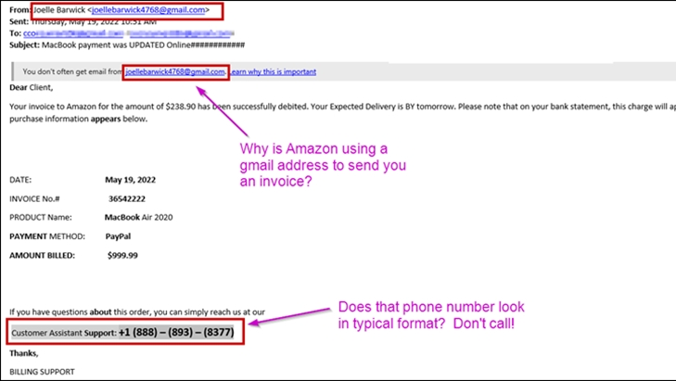
Examples of Phishing Attacks

Slide 4
Types of Phishing Attacks
Social Engineering
Def: Deceptive emails to extract information
Examples: Fake security alerts, account verification requrests.
Email Phishing
Def: Manipulating individuals to divulge private information
Impersonation, emotional manipulation
Website Phishing
Def: Fake websites imitating legitimate ones.
Examples: Fake login pages

Slide 5
How Can I Identify Phishing?
Emails
Check Sender's email.
Verify email content
Look for spelling or grammatical mistakes
Hover over links to preview URLs.
Normally, there is a sense of urgency in these emails.
Websites
There is no HTTPS
Lots of pop-up ads
Check the URL

Slide 6
Best ways to avoid Phishing
Never share passwords via email
Use Two Factor authentication
Verify requests for sensitive information
Keep Software updated and use security software
Educate and train employees
Regularly backup important data

Slide 7
Thank You!

